Slide 1
Interactive Notebooks
for Ms. Freeman's Class

Slide 2
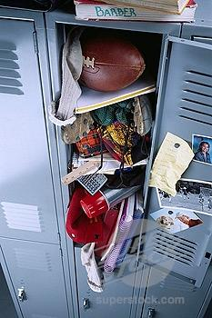
What is an Interactive Notebook (iBook)?
An Interactive Notebook:
is like a personalized textbook that you create
helps you keep your notes organized and easy to use
is a portfolio to showcase what you've learned in math class

Slide 3
What's the Point?
to help you learn and remember important math concepts
allow you to show what you've learned using the RIGHT side of the notebook
to react, reflect, organize, and interpret on the LEFT side of the notebook

Slide 4
How Does an iBook Work?
Your iBook is set up with a left-side/right side orientation.
The left side is for input, or information that is given to you by Ms. Freeman
The right side is for output, this is where you process what you have learned.

Slide 5
Left-Side/Right-Side Setup
Left Side (Input)
Learning Goal:
this will be the actual language
of the Standard
Interactive tool for the concept
this can include definitions,
other tools and examples
Right Side (Output)
Learning Goal:
this is the goal in your own
words
What I Know:
1-2 sentences on what you know
already
What I Learned:
1-2 sentences explaining any
new information learned
Proof:
sample problem; explain with
pictures and words, too!
Reflection:
reflect any way you choose – for
example….

Slide 6
Reflection options:
poem
summary paragraph
rap/song
crosswords - vocabulary
picture of math in action
ideas about activity/lesson
How can it be improved?
anything creative that you can think of…. as long as it is a reflection of the days work.

Slide 7
Traffic Light Comprehension Dot
When you have finished with the reflection, place a comprehension dot next to the page number.
GREEN: Go! Ready to move on.
YELLOW: Slow down! Need to review.
RED: Stop!

Slide 8
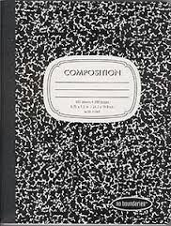
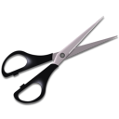
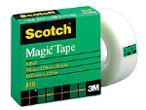
What Do I Need to Get Started?
To make your iBook, you'll need the following materials:
composition book
colored pencils
scissors
highlighter
tape
Hint: Use a plastic cup to hold your materials in your study space at home.
For class work, the materials are provided through community supplies, so there is no reason to travel with them in your backpack.

Slide 9
How Will I Be Graded?
You are responsible for:
making sure your iBook has all items (even when you are absent)
assignments
class work
notes
etc.
keeping Table of Contents up to date
dating and numbering all pages
keeping notebook neat and organized
You can take the iBook home, but it MUST be brought to class EVERY DAY

Slide 10
EVERY
DAY!!!!

Slide 11
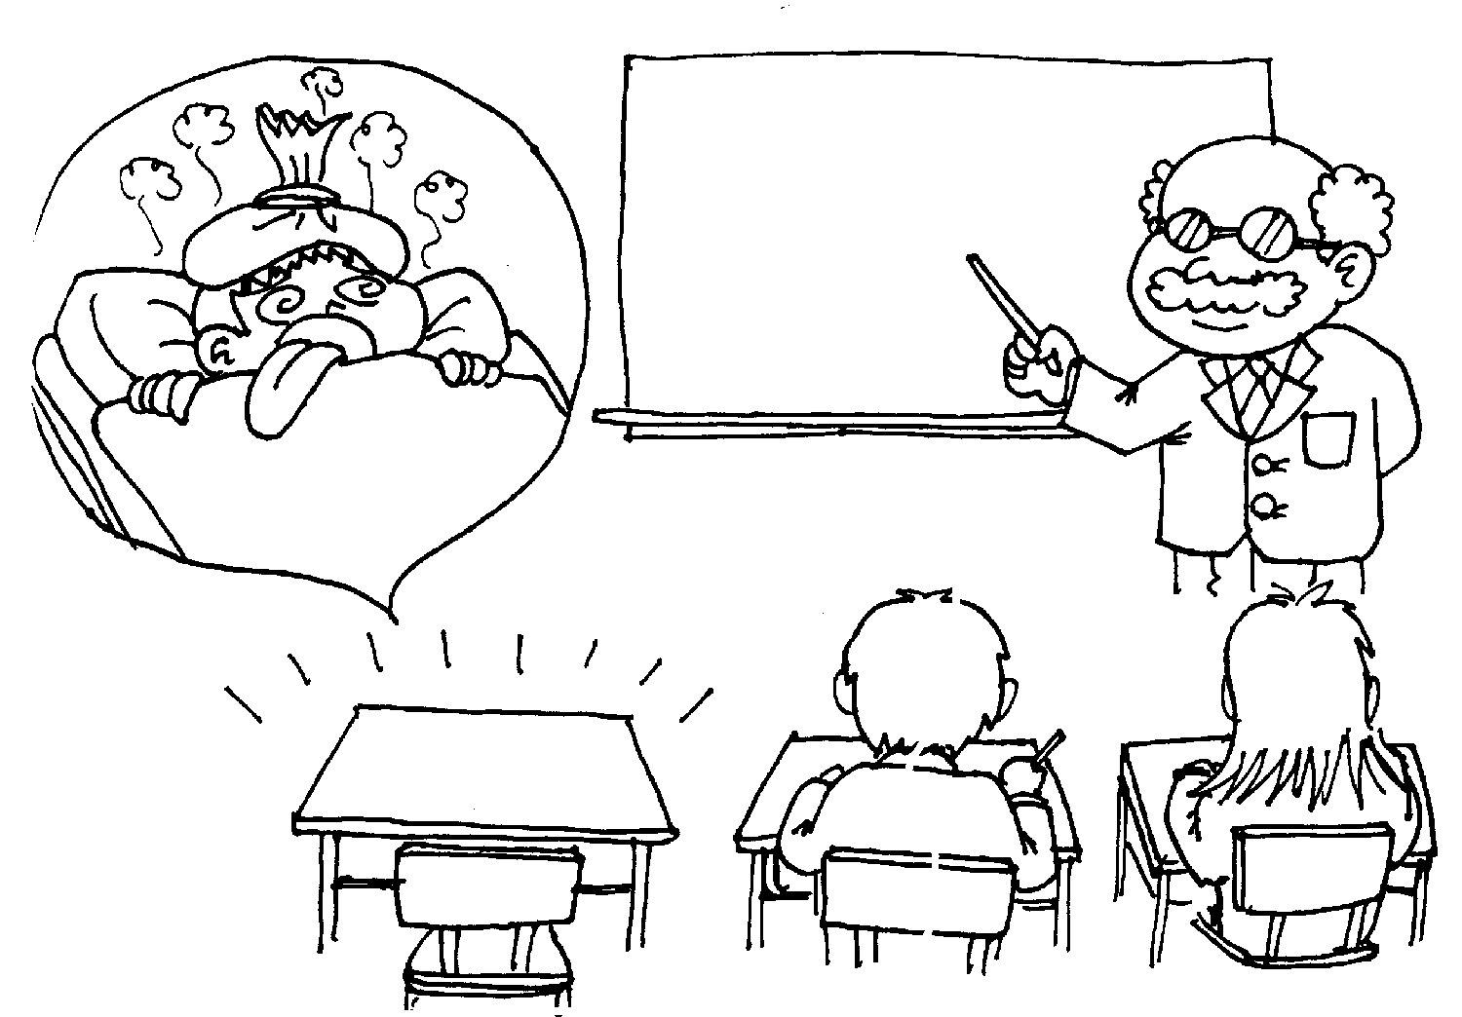
What Happens If I Am Absent?
See a trusted friend to copy notes
Check Ms. Freeman’s copy of the iBook to see what yours should look like
Get any interactive tools you need from the bottom drawer of the rainbow cart

Slide 12
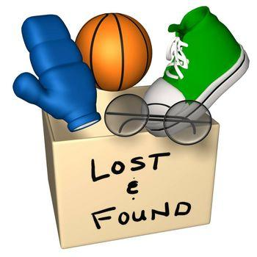
What If I Lose My Interactive Notebook?
Tell me as soon as possible!
Do not quit working on assignments
Come to school early or stay after school to get help rebuilding your notebook
Collect interactive tools from the bottom drawer of the rainbow cart

